Slide 1

Building RESTful APIs
BHG
C# and .NET Core developer focus

Slide 2

Purpose : Knowledge Transfer (KT) session
Understand RESTful APIs, coding, documenting and best practices
Notes:
Notes to presenter:
What is your purpose for sharing this reflection?
Is it at the end of a unit or project?
Are you sharing this reflection, at the attainment of a learning goal you set for yourself?
Is it at the end of a course?
State your purpose for the reflection or even the purpose of the learning experience or learning goal. Be clear and be specific in stating your purpose.

Slide 3
Outline
Welcome
REST Overview
Designing a RESTful APIs URIs
Return Codes
Versioning
Auto-Documentation

Slide 4
1. Welcome
Marty Mazurik, mtmazurik@bhg-inc.com
Training & Consulting Microsoft Partner Company for 11 years
Authored 20+ courses for instructor-led training delivery
C# since .NET 1.0, other languages before that (C/C++, VB, Java)

Slide 5
Goals
Understand REST the history and specification(s)
Know the usage of VERBs and uniform URIs
Learn how to design and compose API endpoints
Know how and when important Versioning should take place
Know about auto documentation with Swagger
LAB Exercise(s): fun, hands-on work, to cement your skills
Have a handout to follow, with hyperlinks for advanced study

Slide 6
Tools We’ll Use: for code & exercises
Visual Studio 2019 (VS2019)
Postman
Swagger/Swashbuckle
Solution repo : https://bhggit/projects/LM/Training-RESTAPI

Slide 7
2. REST Overview
What does a Representational State and Transfer mean?

Slide 8
REST Terminology
HTTP Spec 1.1, fascinating read, 176 pages of stuff you’ve used
R.E.S.T. – Representational State Transfer
JSON – Javascript Object Notation
URI – Uniform Resource Identifier; the lingua franca of REST “Information hiding is one of the key software engineering principles that motivates the uniform interface of REST.” Roy Fielding, Section 6.2 REST Applied to URI
“At no time whatsoever do the server or client software need to know or understand the meaning of a URI -- they merely act as a conduit through which the creator of a resource (a human naming authority) can associate representations with the semantics identified by the URI”

Slide 9
History of ‘remote’ API architectures
RPC’s / Remote Method Invocations (80’s) (Stubs/type-safe bindings)
DCOM / CORBA (90’s) – Object model interop/lang agnostic
SOAP/WSDL 1.1 (2001)
REST (Fielding thesis) (2000) , Flickr 08/2004 implemented an API
graphQL (2015)
gRPC & protocol buffers (Google, 03/2015 release)

Slide 10
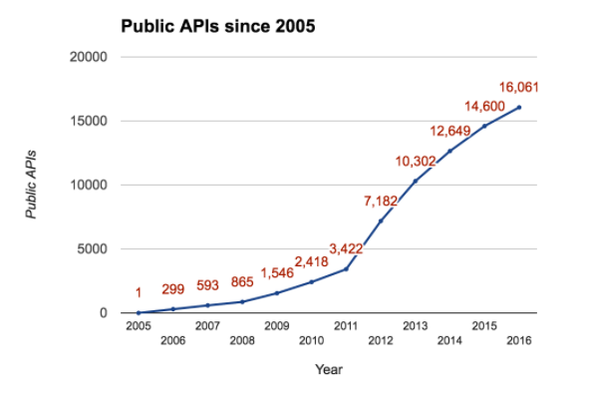
REST Growth curve

Slide 11
Why do you need a WEB (REST) API ?
The API may be accessed by different systems
You are publishing a Public interface for customers
You are Building an App that is a SPA (like Angular, or React)
You are Building a Website of any kind (Internet or intranet)
You are containerizing your systems component services
You are building a Cloud based solution that other systems will access

Slide 12
Where might you not need an API?
You are building a WPF MVC App with or without a DAL
The functionality you intend others to utilize is easily packaged (NuGet or npm)
You are building a BATCH application that exposes no functionality (computational or data intensive)
Embedded systems
Other compute scenarios where no functional programmatic Interface is needed

Slide 13
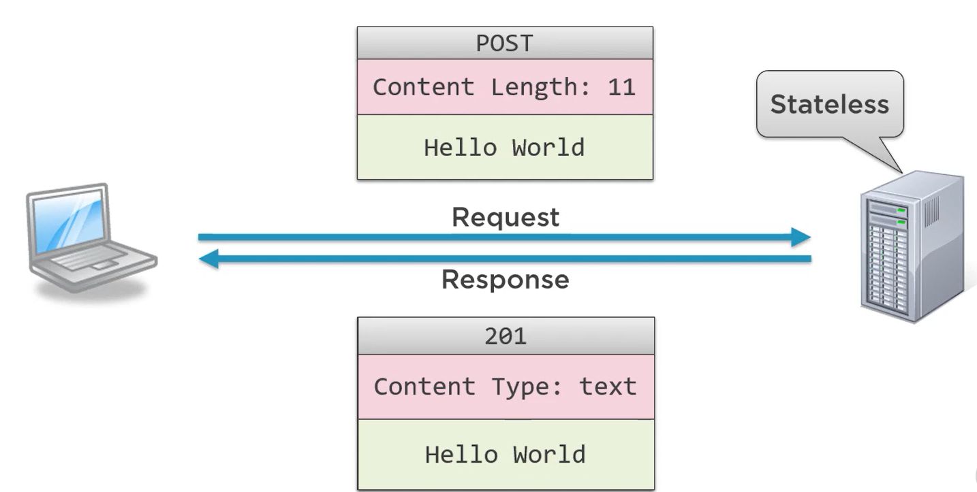
HTTP review (simple POST)

Slide 14
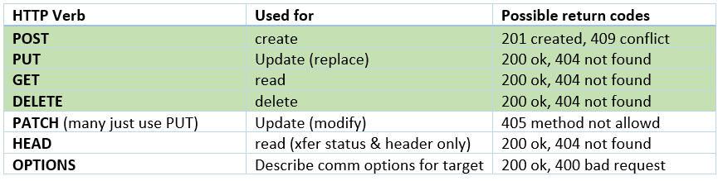
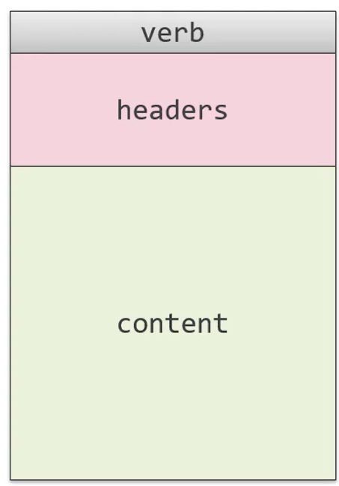
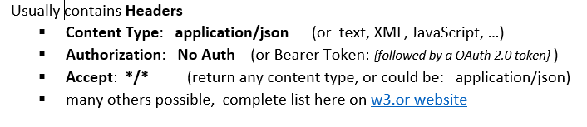
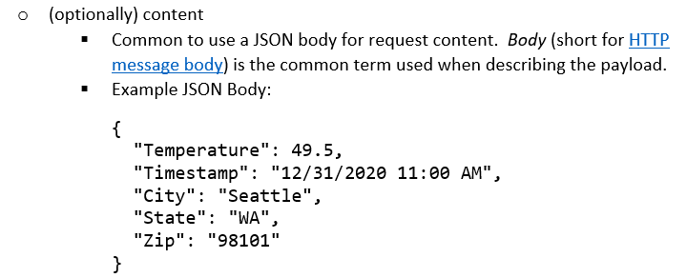
Request

Slide 15
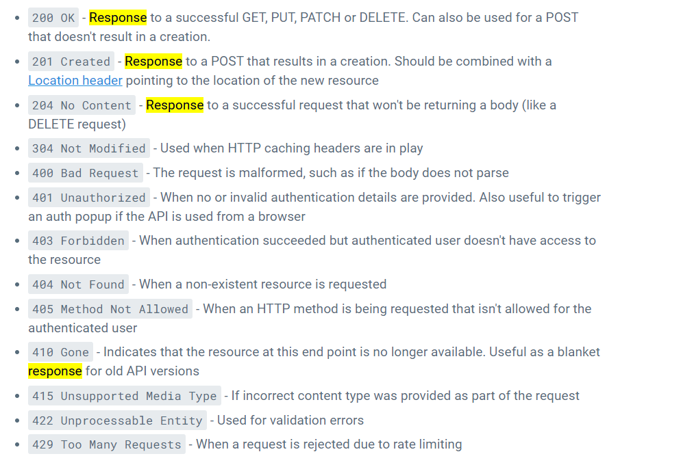
Response == CODES (GET has Body-JSON)

Slide 16
REST : 6 guiding principles
Separate the UI from the data concerns (client-server)
Stateless – each REQ contains ALL the info necessary
Cacheable – response data can be implicit or explicit
Contract-First, Uniform URIs : Identify, Manipulate, Self-descriptive, HATEOS
Layered Architecture – API gateways, Routers in play
Code-on-Demand (optional) – instead of JSON payload, you are free to return executable code (widget UI, etc)

Slide 17
Designing RESTful APIs
Working the URIs

Slide 18
Rules for REST API / URI design
Use Collection Pattern ( /loans/guarantors ) for representational state description
Use plural form (like in SQL Server table names)
No trailing forward slash (/) needed
Forward slash indicates hierarchy (localhost:8192/lms/loans/guarantors/3214 )
Don’t use ‘API’ in URI
What follows IP:PORT, in most languages is the controller name, or (“authority”)
Services will be known by their DNS : PORT (or IP address: PORT)
Think lowercase always. Not or Pascal-casing or camel-casing for these URI name parts
Use hyphens as separators (not underscores) in long names, or in place of spaces
Don’t use file types (instead rely on Header Media-Type), Avoid .(dot) operators
Use appropriate HTTP status code in Response to Request

Slide 19
Possible Exceptions to URI rules
You may want an ‘action’ (PATCH localhost:8192/lms/activate )
But? Can also be construct via: PATCH localhost:8192/lms with a JSON Body { “Activate”: true }
Sometimes you have no way to map to a Collection, say a multi-resource search across several resources: GET localhost:8192/bhg/search?empid=1234
Some like the pattern of VERB-NOUN if an exception is needed: POST /rockets/43/launch-rocket (action by the service)
I use exception all the time for PING localhost:8192/lms/ping sanity check

Slide 20
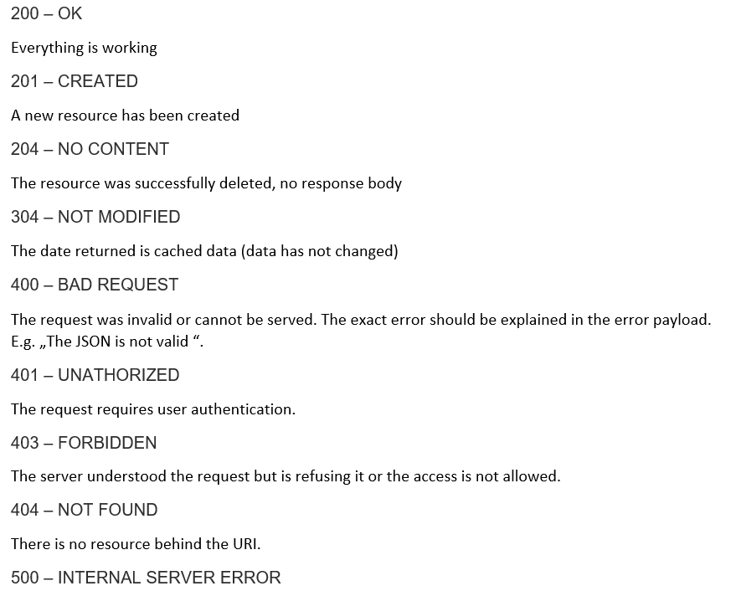
Return Codes (common)
A word about HTTP 500:
If an error occurs in the global catch block, the stack trace:
should be logged and
not returned as a response
API developers love to build wrappers and encapsulate stacks and return them to debug. Avoid this tendency and use API instrumentation and logging instead.

Slide 21
Demo: Code
Looking at .NET Core code syntax for a simple REST API

Slide 22
Versioning
Public APIs should be versioned

Slide 23
Versioning guidelines
A formally published API (like a Public API release) should be versioned
Within a company, often the creator of the service “Wags the dog”
Breaking changes after a release require new Major release number
Non-breaking changes can be kept track of with Minor release number
Changes : REQUEST and URI and Body and REPLY and Body changes
Swagger becomes the source of truth, before and after release

Slide 24
How to Version (2 ways)
Visible in the URI (URI versioning)
http://myapi.bhg-inc.com/v1/
In the Request header, using negotiation at the service side
Accept-version: v1
Or
Accept-version: v2

Slide 25
Swagger
Autodocumentation for your RESTful APIs

Slide 26
Auto-documentation
Swagger – the framework for notating REST APIs
OpenAPI – the standard specification
Swashbuckle – .NET generator package
Triple-slash comment – your descriptions of routines

Slide 27
Why Swagger?
Uses common language devs and non-devs can understand
Can be used for testing and bug fixing (invoking methods)
Save writing (and editing) documentation on API – its automatic!
Industry standard: donated to OpenAPI by SmartBear, in 2015

Slide 28
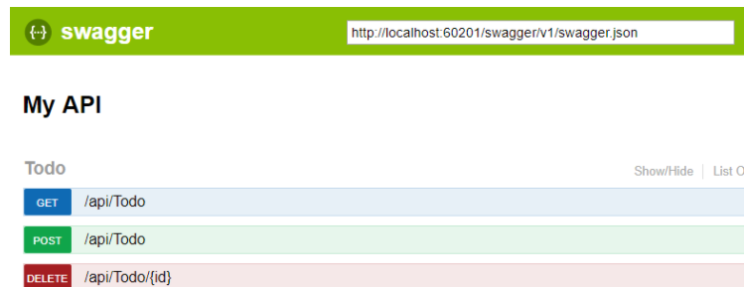
How it works:
You register middleware in your .NET core Startup.cs
openapi.json file generated
A Swagger UI (browser based)
UI used for doc or actual calling

Slide 29
Demo
Quick Demo of Swagger in action

Slide 30
Review
REST API foundations and HTTP Specification/RFC’s
VERBS commonly used ( POST,GET,PUT,DELETE) (C.R.U.D.)
Designing APIs using the ‘Collection pattern’
11 Design guidelines (general rules to follow) & Exceptions
Handy JSON-to-Csharp conversion site ( JSON/Message first)
Return Codes (simplicity and brevity)
Versioning importance & timing
Auto-documentation with Swagger/Swashbuckle

Slide 31
Exercises ( self-paced learning )
Section 7 – Instructor Notes & Exercises Document
Implementing Simple POST (Create) for MyAPI
Implementing More ‘Collection Pattern’ Methods for MyAPI
Adding Swagger (auto documentation) to MyAPI

